Slide 1
Towards Ghost-free Shadow Removal via Dual Hierarchical Aggregation Network and Shadow Matting GAN

Slide 2
Features
to learn the border artifacts-free image
Dual Hierarchically Aggregation Network (DHAN)
novel network structure named the
Create synthesized shadow images
Shadow Matting GAN (SM-GAN)
synthesize realistic shadow mattings from a given shadow mask and shadow-free image
In our shadow synthesis, we assume the scenes contain only cast shadows with the objects outside the scene.

Slide 3
Shadows
Cast shadows, which often appear in the opposite direction of a light source, form when the light from an illuminant is blocked by an object.
Removing these shadows is essential because shadows may degrade the performance of many computer vision tasks, such as object detection and tracking

Slide 4
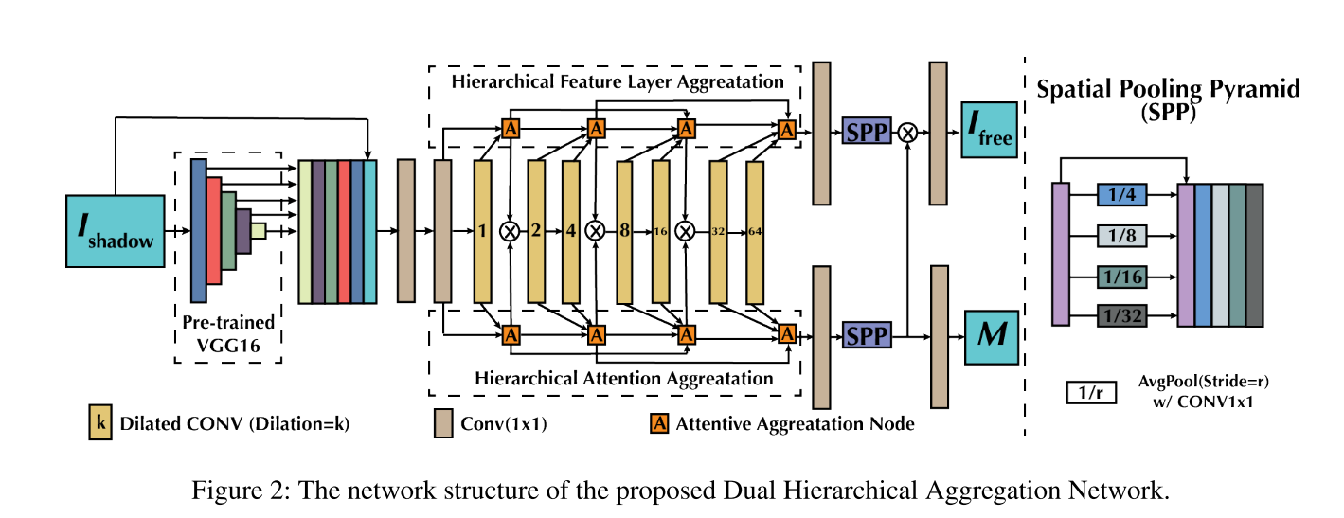

Slide 5
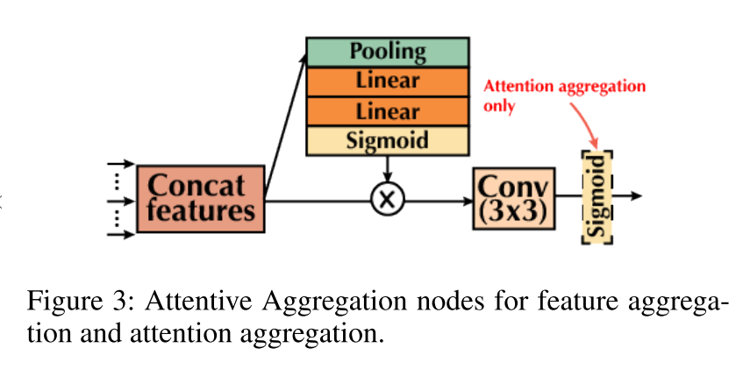
N-layer dual hierarchical aggregations (DHAN_{n})
To learn the shadows and preserve low level details
build the attention module by aggregating the features from multiple previous layers in a hierarchical layer aggregation style

Slide 6
Loss functions
multi layer perception loss
estimate the differences from convolution network and the original images between the natural shadow-free image I_{free} and the generated I’_{free}
attention loss
use the binary cross entropy (BCE) loss between the predicted mask M’ and the ground truth mask M
convolution neural network might also preserve the shadow border in the images, which will also degrade the shadow removal quality
Use adversarial loss
Which in turn uses a Discriminator loss

Slide 7
SM-GAN: Shadow Matting GAN
the environmental light changes so fast that it is impossible to take pairs of shadow/shadow-free images under the same light conditions, even in a flash.
The uncertainty of the light transforming between shadow/shadow-free images influences the accuracy of the network.
SM-GAN has a similar structure with the CycleGAN

